Slide 1








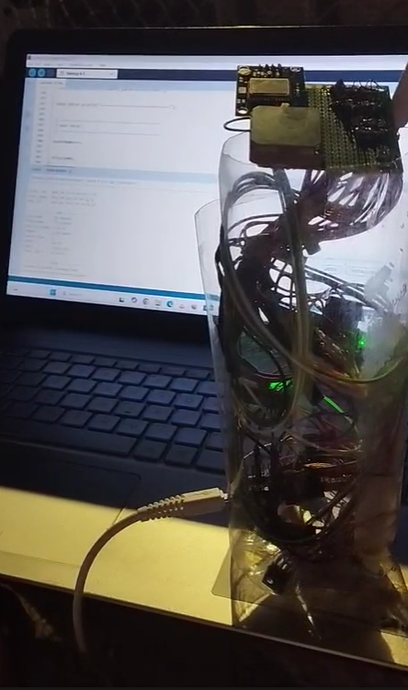
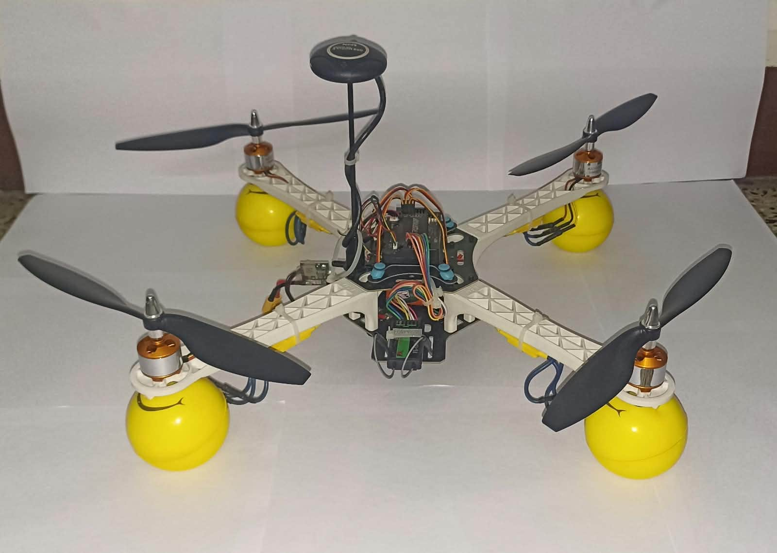
Ignisia
THINK. BUILD. EVOLVE.
INCUBEX
Track:
Prototype Expo Track
Theme:
Aerospace & Space Technology / Hardware
Title:
AeroSync : Hybrid CanSat Telemetry & Launch Vehicle System
Team ID:
0007
Videos: https://drive.google.com/drive/folders/12sinTi2cqTp08u40LJMLwo98TNp7EeID

Slide 2


Problem and limitations of existing solutions
⚡ WHY EXISTING SOLUTIONS FAIL — AND WHY WE BUILT SOMETHING BETTER
📡 DELAYED DATA
Delayed Data Recovery
Platforms require full recovery before data is accessible — zero real-time insight.
THE OPPORTUNITY
──────────────────
📍 Why It Matters
Altitude-based data powers weather forecasting, precision agriculture, disaster response and environmental monitoring — yet inaccessible without costly infrastructure.
🎯 Our Focus
Affordable, integrated sensing of environment, illumination, motion, and GPS in a single compact airborne platform.
🛰 CUBESATS
Requires orbital launch infrastructure. High cost — inaccessible for rapid prototyping.
HIGH COST
💰 PROHIBITIVE COST
Prohibitive Cost
Orbital infrastructure and satellite-grade hardware prices out student and research teams.
🎈 WEATHER BALLOONS
Limited real-time telemetry. Data retrieved only after physical recovery of payload.
DELAYED DATA
🔩 FRAGMENTED SENSING
Fragmented Sensing
Environmental, motion, and navigation data require separate, incompatible systems.
🔬 LAB INSTRUMENTS
Stationary by design. Cannot capture altitude-varying atmospheric profiles in the field.
NO MOBILITY
COMPACT · AFFORDABLE · REAL-TIME
📊 Altitude-based data is critical — yet no affordable, integrated, real-time solution existed. Until now.

Slide 3


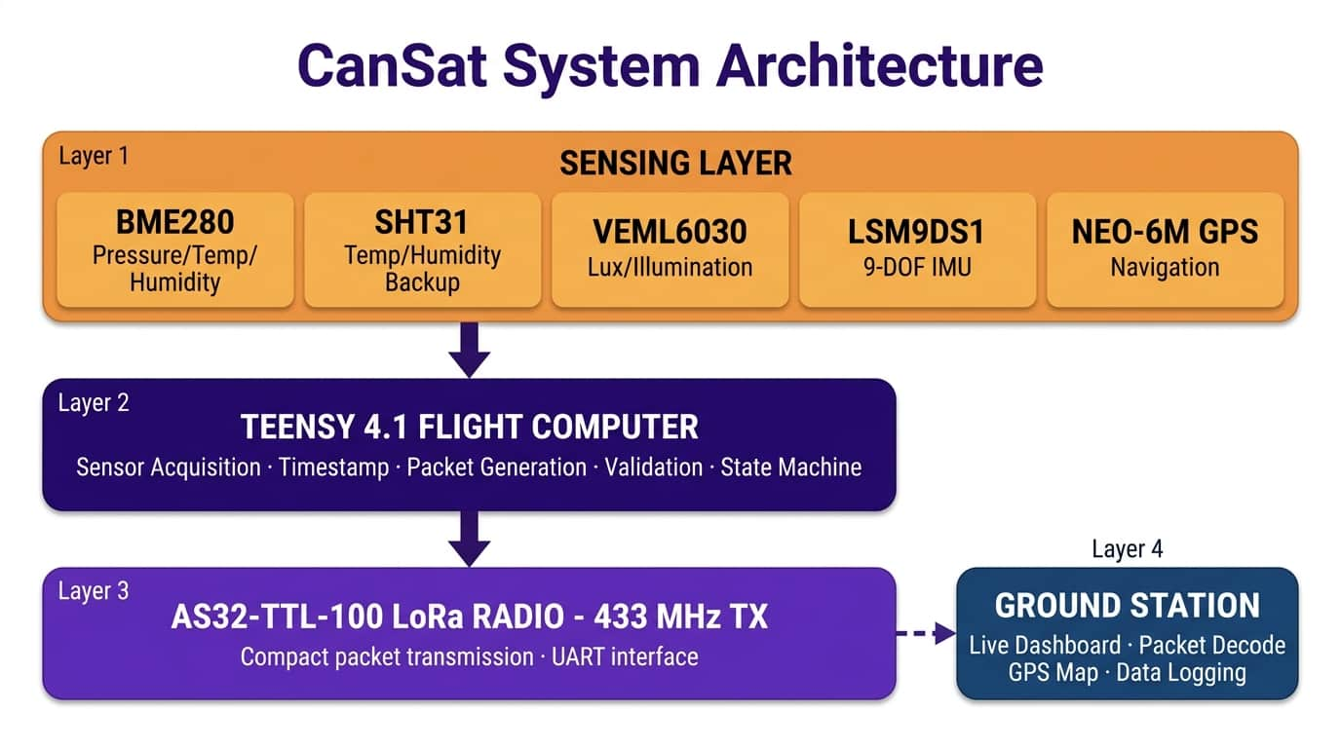


Our Solutions and it’s USP
Solution Description
Features & USP
The Teensy 4.1 collects, timestamps, and validates environmental, illumination, motion, and GPS data before transmitting telemetry to the ground station via 433 MHz LoRa
REAL-TIME TELEMETRY
GPS NAVIGATION
433 MHz LoRa transmits live sensor, GPS, and motion data to the ground station.
NEO-6M provides position, altitude, speed, satellite count, and HDOP.
🌡️ MULTI-DOMAIN SENSING
CROSS-VALIDATION
Measures pressure, temperature, humidity, illumination, and 9-DOF motion.
BME280 and SHT31 cross-check temperature and humidity readings.

Slide 4
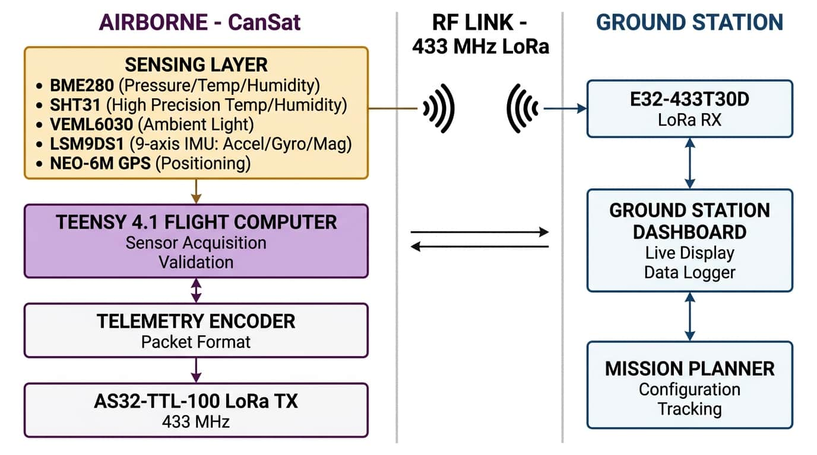









Technical Architecture
Tech Stack
FLIGHT HARDWARE
System Architecture Diagram
Teensy 4.1 | 600 MHz ARM M7 flight computer
BME280 | Pressure, temperature, humidity
SHT31 | Independent precision temp + humidity cross-check channel
VEML6030 | Ambient illumination sensing
LSM9DS1 | 9-DOF accelerometer, gyroscope, magnetometer
NEO-6M GPS | Position, altitude, speed, HDOP
COMMUNICATION & SOFTWARE
AS32-TTL-100 | 433 MHz LoRa radio; airborne long-range transmitter
E32-433T30D | Ground-side 433 MHz LoRa receiver module
C++ / Arduino | Embedded firmware language and real-time environment
TinyGPS++ | Lightweight NMEA stream parser for navigation data
Mission Planner | ArduPilot telemetry display & drone mission mapping
Compact · Modular · Real-Time · Multi-Domain | Sensors → Teensy 4.1 → 433 MHz LoRa → Ground Station Live Dashboard

Slide 5

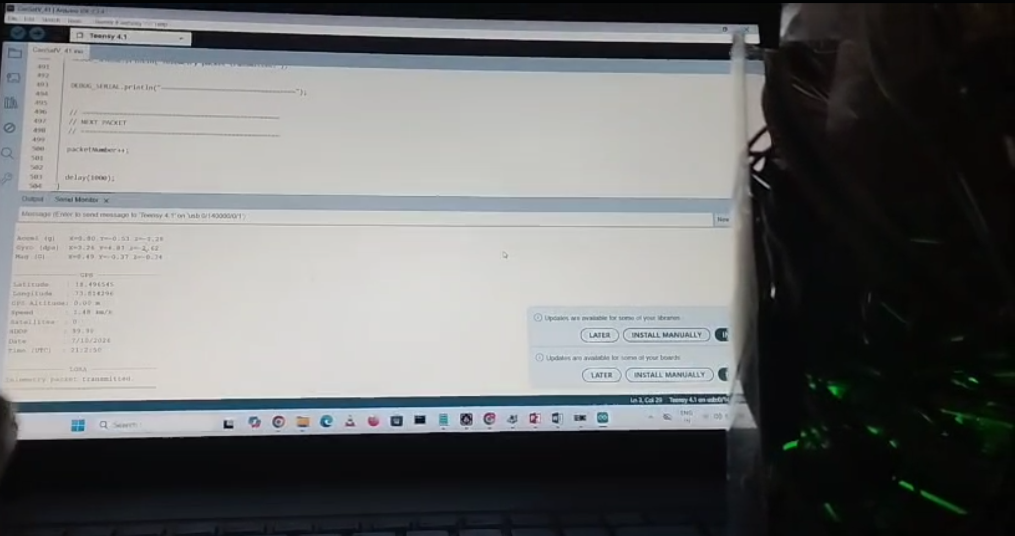
Working of the Solution and Demonstration
🚀 LAUNCH & EJECTION
🌡️ SENSE & PROCESS
📡 TRANSMIT — 433 MHz
🖥️ GROUND DISPLAY
CanSat ejected from carrier vehicle; mission timer starts
9 sensors sampled; Teensy 4.1 encodes telemetry packets
LoRa radio broadcasts structured packets every cycle
Ground station decodes, logs, plots and maps live data
Methodology
CanSat Images
Charts
ALTITUDE PROFILE — CanSat Mission (Simulated Telemetry)
POWER ON
LAUNCH
Sensors initialize; GPS acquires 3D fix; hardware health check passes.
CanSat ejected from carrier at apogee; mission timer begins automatically.
TEMPERATURE PROFILE — Descent Phase
LANDING
DESCENT
CanSat Payload —+ LoRa TX + GPS + BatteryTeensy 4.1 + 5 Sensors
Final landing GPS fix and battery status sent; mission elapsed time logged.
Parachute deploys; continuous descent telemetry; GPS tracks location.
9 Params
Logged in sync
~2 s
Packet interval
>95%
Packet delivery
Live Ground Station — Real-time telemetry decoded and displayed

Slide 6




Impact and Benefits
Social / Environmental / Governmental
Environmental Monitoring
Precision Agriculture
Disaster Response
Accessible Aerospace
GPS-tracked telemetry supports aerial reconnaissance and atmospheric monitoring during extreme events.
Affordable, modular hardware gives students hands-on experience in aerospace engineering and telemetry.
Real-time atmospheric data supports microclimate analysis, climate research, and environmental monitoring.
Altitude-based sensing helps study crop microclimates, temperature variations, and heat stress.
How solution addresses the problem
Real-Time Telemetry
Aerial Sensors
BME280 · SHT31 · VEML6030
LSM9DS1 · u-blox GPS
Teensy 4.1
Real-time processing,
timestamps & validation
433 MHz LoRa
AS32-TTL-100 long-range
airborne radio broadcast
Ground Station
Live telemetry dashboard,
GPS track & CSV logging
Intelligence
Localized atmospheric data,
heat stress & hazard analysis
• 433 MHz LoRa link transmits live altitude, temperature, humidity, GPS, and motion data no post-recovery wait.
Multi-Sensor Environmental Sensing
• BME280 + SHT31 + VEML6030 + LSM9DS1 provide cross-validated atmospheric, illumination, and motion data.
GPS Navigation & Tracking
• u-blox NEO-6M provides real-time position, altitude, speed, and satellite count — enabling aerial tracking.
CanSat → Atmospheric Data → Real-Time Telemetry → Environmental & Disaster Intelligence

Slide 7
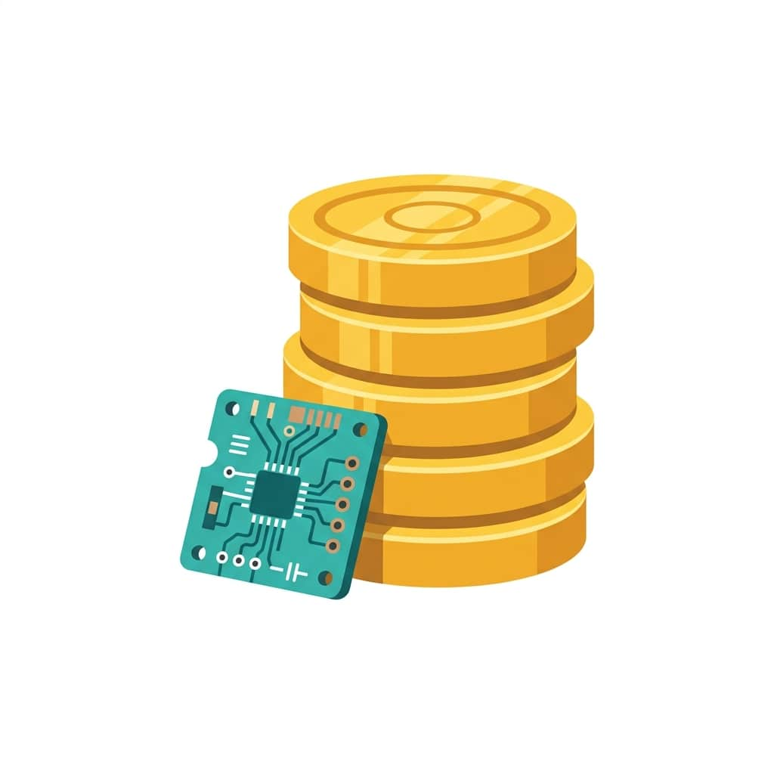


Future Plan and Feasibilty
Challenges and Mitigation
CHALLENGES & RISKS
MITIGATION STRATEGIES
GPS Signal Loss
• Temporary loss of GPS positioning.
• Flag invalid GPS data; continue sensor and IMU telemetry.
Radio Link Interruption
• 433 MHz signal dropouts or interference.
• Packet counters identify losses; transmission resumes after reconnection.
• Voltage drops or sensor faults.
•Log battery voltage; cross-check temperature and humidity readings.
Power & Sensor Reliability
Economic Viability and Commercialisation Scalability
Low-Cost Modular Platform
Scalable & Extensible Architecture
Commercialisation & Deployment Path
Teensy 4.1 and off-the-shelf sensors. Build cost under ₹8,000.
Modular I²C/UART interfaces enable additional sensors and dashboards.
Potential applications in agriculture, weather monitoring, and disaster response.
Future Scope
Web Ground Dashboard
Autonomous Event Detection
Sensor Fusion & Estimation
Drone Payload Integration

Slide 8
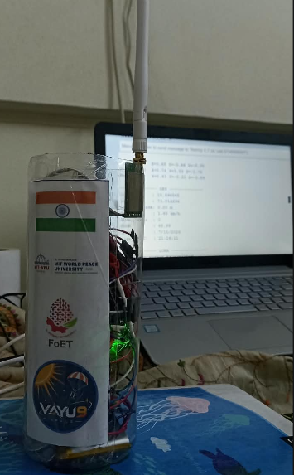
Research and References
[1] Design of Trash Can Sized Satellite for Air Quality Monitoring at an Altitude of 300m Above Ground Level.
Summary: Presents a compact CanSat designed to monitor air quality at 300 m altitude, using LoRa telemetry, a parachute-based descent system, and a ground station for receiving sensor data. Highly relevant to CanSat hardware and communication architecture..
Link: https://ieeexplore.ieee.org/document/10245113/
[2] Swayampakula et al., “Design and development of a CanSat for air pollution monitoring with RSSI based position retrieval system,” Advances in Space Research, Vol. 75, Issue 9, 2025.
Summary: Describes a lightweight CanSat for atmospheric and air-pollution monitoring using temperature, humidity, and gas sensors. Covers telemetry, position retrieval using received signal strength (RSSI), power conservation, and parachute-based descent.Link: https://www.sciencedirect.com/science/article/pii/S0273117724001856?via%3Dihub
[3] N. Sako et al., “CanSat suborbital launch experiment—university educational space program using can sized pico-satellite,” Acta Astronautica, Vol. 48, Issues 5–12, pp. 767–776, 2001.. Summary: Presents the design, objectives, suborbital launch experiments, and lessons learned from a can-sized pico-satellite project. Useful for explaining CanSat mission design, deployment, and experimental validation.
Link: https://linkinghub.elsevier.com/retrieve/pii/S009457650100039X
[4] “A pico-satellite assembled and tested during the 6th CanSat Leader Training Program,” Journal of Applied Research and Technology, Vol. 15, Issue 1, pp. 83–91, 2017. Summary: Describes the construction and testing of a small satellite carrying temperature and humidity sensors. Includes GPS-based position data and atmospheric measurements during flight, making it useful for sensor integration and experimental testing.
Link: https://doi.org/10.1016/j.jart.2016.10.003
Videos: https://drive.google.com/drive/folders/12sinTi2cqTp08u40LJMLwo98TNp7EeID

